Slide 1
CTD Advanced Training – Day 3
Combinatorial Test Design (CTD)

Slide 2
Outline
Various Approaches of Applying CTD
Existing Tests
Coverage Analysis
Trace File
Augmentation
Test Selection
Test Plan Alternatives
Other Features

Slide 3
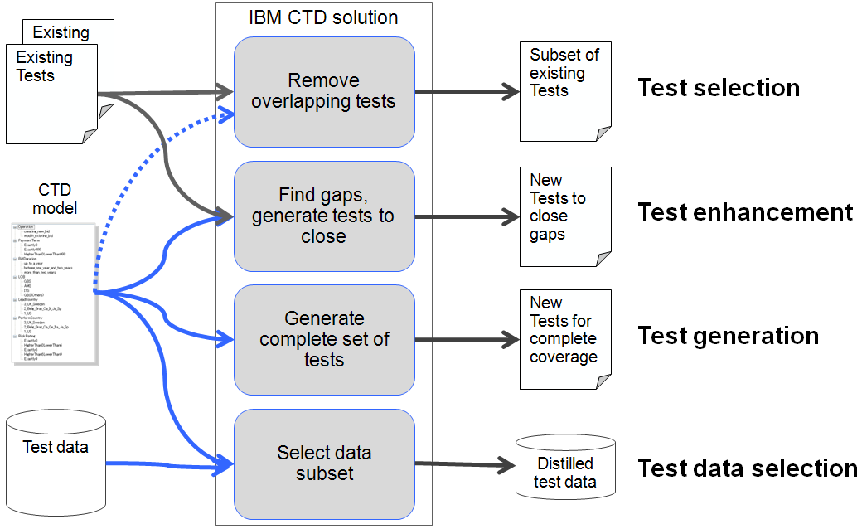
When to apply CTD?

Slide 4
Existing tests
Customers have already made major investments in creation of tests.
Customers have trusted tests suits.
In all likelihood, there is much redundancy in these test suites.
On the other side, there are usually large coverage gaps in them
FOCUS can:
  Analyze existing test suites
  Reduce / remove redundancy
  Extend the test suite to close coverage gaps

Slide 5
Trace File
A trace is a list of tests, represented by assigning a value to each attribute
When building a trace file, always create a column at the beginning of the trace file and call it TC#. This is to make sure that each test case is unique and you can trace back to the existing pack so that we can ensure the full pack is assessed for coverage.
  Note : TC# shouldn’t selected while selecting requirement coverage while defining Level of integration..
FOCUS supports trace files that contain only a subset of the model attributes, or more attributes than the ones in the model. This is helpful for agile testing scenarios where one update the model for the next sprint while reusing test cases from the previous sprint
Any existing test cases that cannot have an attribute or value associated in the trace file must be left blank ( these will be ignored when loaded into the tool and not count towards the coverage)
Coverage analysis, Augmentation, & Test Selection require the existing tests to be represented as traces
Easiest method is to read existing test cases and convert them into a single CSV file which expresses the attributes & values
Can be difficult to translate into CSV if the test cases infer a lot of information not specifically mentioned

Slide 6
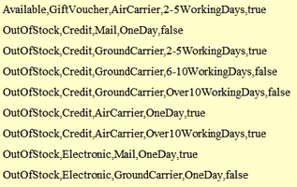
Traces file Format
CSV Files
  Editable (Notepad, Excel)
  Extension “.csv”
  First line is attribute name
  Commas between values
  Booleans lower or upper case
Notes:
The second format option that FoCuS accepts is a CSV file, which is merely a simple text file editable in for example Notepad or Excel with the extension.csv and the following format:
The first line shows attribute names
There are commas between values
Booleans are either lower or upper case

Slide 7

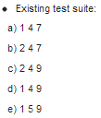
Interaction Coverage
In order to measure coverage, existing test cases must be “modeled” using trace files
Use model attributes & values to reverse engineer existing test cases by assigning the correct values
If a value cannot be derived for the test case leave it blank ( a test case must be repeatable if its not then a tester can run the same case multiple times with a different result)
Notes:
As you've seen, CTD's building blocks for test solution are attributes and values. The FoCuS model is built on the specification of attributes and values, and the test solution generated by FoCuS is a set of combinations that defines the value to be used for every attribute in each test case.
In order to measure coverage, the existing tests need to be described as combinations of attributes and values.
You use attributes and values to represent existing tests. Each test is a combination in which each attribute gets a value. The interaction coverage requirements are handled the same way as when tests are generated.
To get a test suite, you define the interactions among attributes and values. While there are some interactions that are covered more than once, there are also others that are not covered at all.
A test is an assignment of values to the attributes; for example, (1 4 7), which represents x=1, y=4, z=7. A test suite is a collection of such tests.
For example, some covered pairs are: (1,4), (1,5), (1,7)
Not all pairs are covered

Slide 8
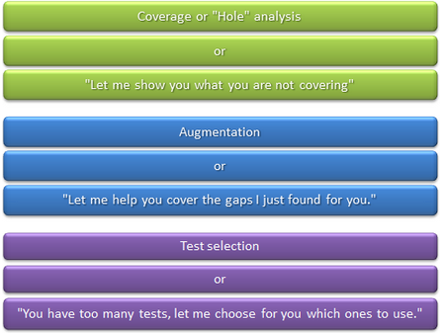
Utilizing Trace Files
Notes:
There are three complementary approaches to handling existing tests:

Slide 9
Coverage / Hole Analysis
Build model, input trace file, add interaction requirements
Depth of search
  Choose # of attributes
  Choose which attributes
  Add coverage requirement
Hands On
Notes:
When you perform a coverage analysis, also known as hole analysis, you must input the model, the trace, and the interaction requirements in FoCuS. After the analysis is complete, you will receive the required combinations in your model that are not covered by the tests included in the trace.

Slide 10
Test Selection
Sometimes the business requirement is to only reduce the number of tests and not to improve their quality
The customer is satisfied with current test quality, is not interested in creating new tests and only wants to reduce testing cost
  For highly complex business logic, the effort of specifying restrictions might not be cost-worthy
  In some cases, generating test data synthetically requires high effort, often impractical
  CTD-based test selection addresses these three concerns, while CTD does not
  CTD is the preferred solution – test selection is used either when the customer requires it or when CTD cannot be applied due to the above challenges
Run >> Test Selection >> Add Coverage Requirements >> Add Trace File >> Create Report
Hands On
Notes:
Test selection enables the reduction of existing test cases while preserving their n-wise combinations coverage. You will select a subset of your existing tests, while maintaining the same coverage as the input test suite. It is likely that there is much redundancy in the existing test suite, whether alone or as part of the augmented test suite. Given this test suite, you will find a small subset that provides the same interaction coverage as the whole.

Slide 11
How does CTD-based test selection work?
Model attributes and values exactly as you would in CTD.
Apply the same CTD algorithm that you would use to create a CTD test solution.
However instead of applying it to the entire test space – apply it to a given set of tests.
The result is a subset of the existing tests that maintains the same interaction coverage (for given coverage requirements) as the original test suite
-Using CTD reasoning this means that it will find the same defects as the original test suite, up to a certain percentage of confidence
No need to specify restrictions as we are choosing tests out of valid tests only.
No need to generate test data as we are choosing existing tests only.
As part of the Risk based testing we can cap the number of tests created while generating the output by entering the number of tests required.

Slide 12
What are the risks in CTD-based test selection?
Escape of bugs due to incorrect/incomplete identification of attributes and values – same risk as in CTD
–The test solution is only as good as your model
▪Escape of bugs due to their dependency on higher levels of interactions – same risk as in CTD
–A t-way CTD test solution is not guaranteed to find bugs that depend on t+1 attribute values
▪Incorrect expectations of the customer that this approach will improve their test suite effectiveness and not just its efficiency
–This means that the approach was not explained correctly to the customer
–The resulting test suite will only find defects that would have been found by the original test suite
–It is up to the customer to decide whether or not this is the requirement

Slide 13
Test Plan Enhancement
The result of applying test selection on the enhanced test suite. This test plan always achieves 100% coverage, and is typically the one that requires the least number of new tests, while also removing redundancy from the existing ones.
Result of hole analysis determines the need of augmentation.
Create trace for the existing test cases
Create CTD model
Perform Augmentation to fill the coverage holes
Demo
Notes:
This section shows how to create tests that fill coverage holes. This process is called Augmentation.
When performing tests of existing test suites, it is very likely that there are many coverage holes.
For augmentation, the requirements that are already covered by the existing test suite are removed from the list of requirements that are passed to CTD.
In other words, FoCuS can assume that the existing tests have been, or will be executed, and suggest a small test solution that covers the gaps left by them.
Most recommended approach by the clients .
Explain on the similarity of the attributes in the model and in the trace file.
Explain on the common scenarios

Slide 14
Test Plan Alternative Report
Test plan alternative report gives view of the CTD outcome test cases for different approaches
  Test Selection
  Enhanced Select (Augmentation)
  CTD from scratch
  Existing Test
  Enhancement
  Modify / Enhance Select
This provides model summary along with the coverage analysis separately for good path and bad path.
For Test selection or Enhanced select or Modify Enhance Select ,the reason for the removed cases can also be verified.

Slide 15
Test Plan Alternative Report – Modify Enhance Select
If the existing tests contain missing values compared to the current model version. In this case, FOCUS will attempt to initialize those missing values (in effect modifying the existing tests, but only in the parts where they are lacking compared to the model), while optimizing the total number of tests
In the report Modify-Enhance-Select tab, added values are marked with red. The report can be exported in html format.

Slide 16

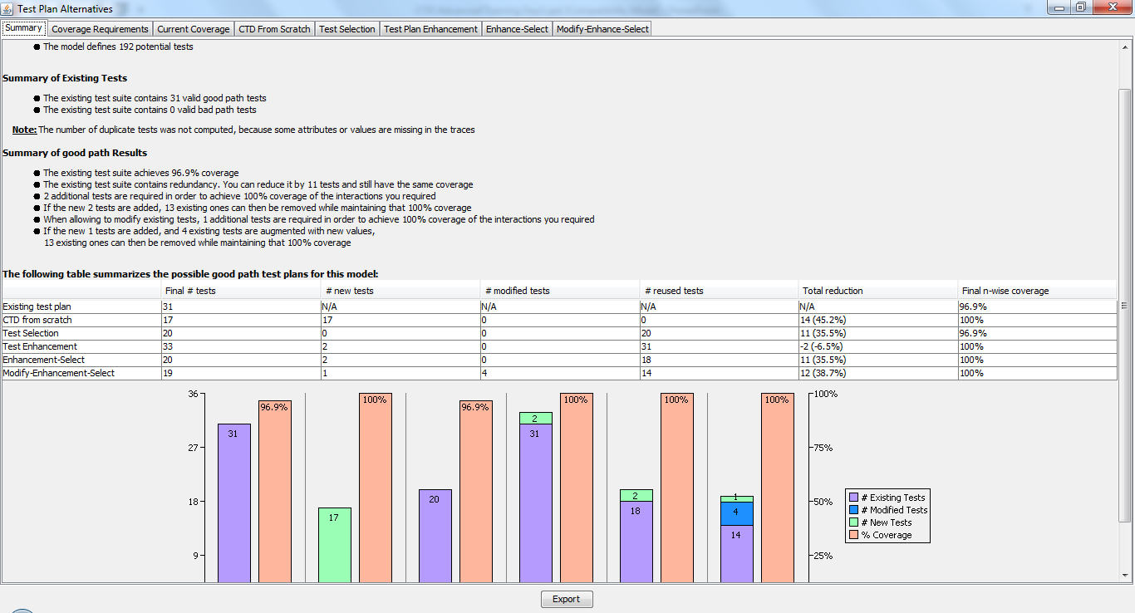
Test Plan Alternative Report
How to view the test plan alternative report
  Hands On
Notes:
Continue with the advantage of this test plan alternative report over agile testing.

Slide 17
CTD in Agile Testing
A base model should be available before the sprint.
For each sprint the existing models will be modified to reflect the requirements/ User stories.
The test plan alternative report clearly presents the different options (including generation from scratch which is always a valid option) and also recommends which tests can be discarded, so it helps reduce the suite despite the accumulated updates
CTD should be thought through as part of overall project strategy , sprint planning and test strategy.
Model agility can be achieved with various features available in tool such as rename of attributes, merge and split of values, comparison view between two versions of model and enable review of the modifications.

Slide 18
User Story for Shopping/Shipping App…Sprint 1
The system shall take orders for any
valid item
,
This specification refers to the following attributes:
  Item validity & in-stock (three values)
  Pricing schemes (3 values)
  Delivery timeframe (3 values)
  Shipping (3 values)
  Customer credit status (3 values)
  Export control status (two values)
  Foreign or Domestic (two values)
This specification implies negative tests
  Customer credit status (“unknown” “denied”)
  Invalid Item
One estimate of the number of tests needed for all combinations of these points of variation is
  3*3*3*3*3*2*2 = 972 potential tests
whether it is
in stock
or
not
.
The system shall support multiple
pricing schemes
for an order.
•
3 pricing scheme
s
The system shall validate the current
credit status
of the
purchaser
, when known.
The purchaser can select one of the following
time
frames
for order delivery:
immediate
,
within
one working week
, and within
one month
.
Ground shipping
is default, while
sea
shipping is
allowed for orders being delivered in a week or a
month, and
air
shipping is allowed for
immediate
or
one
-
week orders
.
When an
item
is classified as
export controlled
, the
system shall generate the appropriate work items
to comply with governmental requirements.
Sprint 1 :Generate Test Cases using CTD

Slide 19
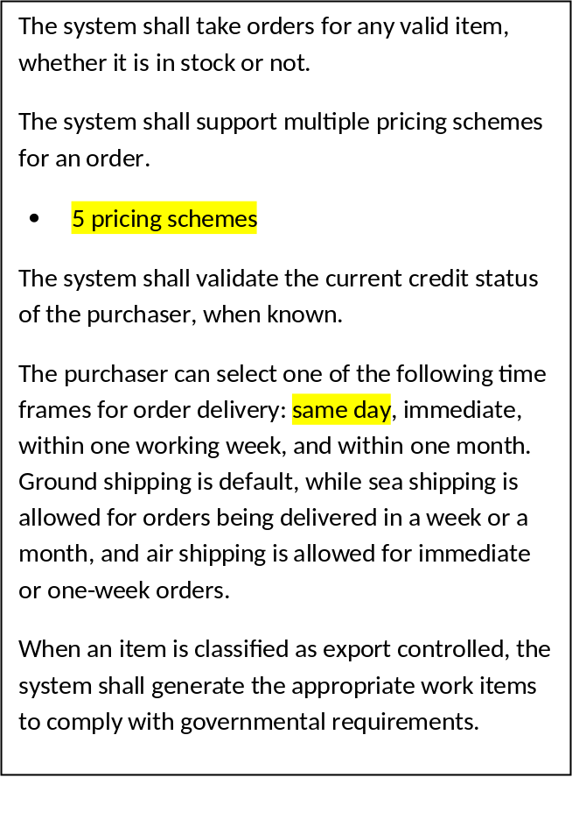
User Story for Shopping/Shipping App…Sprint 2
Added 2 new pricing schemes and same day delivery
Now, many more test cases
  3*5*4*3*3*2*2 = 2,160 potential tests
Sprint 2: Generate DELTA Test Cases

Slide 20
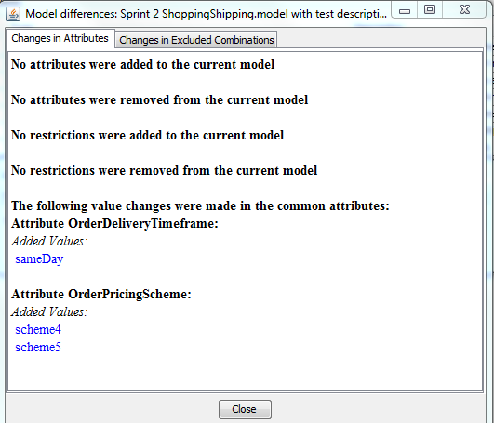
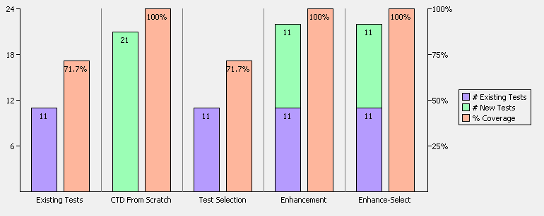
Sprint 2: CTD will generate delta test cases…leaving
test cases from Sprint 1 intact
New test cases needed that cover new functionality for progression testing
Low coverage due to new requirements
No compression, Test Cases optimized in Sprint 1
No compression, Test Cases were optimized in Sprint 1
Existing test cases needed that cover existing functionality and can be part of regression testing.
Reuse Sprint 1 Test Cases thus not an option
Enhance-Select for optimal reuse of Sprint 1 test cases

Slide 21
Model Identification
Capture in FOCUS information that would enable working with a version control.
  The user provides and maintains structured additional information identifying the model and its versions
  A tag is generated based on the model identification fields and can be used externally to tag the model version within a version control system
  Tagging the model is mandatory and is enforced before saving.
Support traceability between the FOCUS model and outputs generated based on this model (e.g. a feature file)

Slide 22
Models can be saved on to GitHub
Using GitHub to store model files allows taking advantage of the version control capabilities. Thus, models versions history is maintained, and models can be easily shared between users within an organization.
In addition, using the model identification tag and fields as described in the Model Identification Section to tag the model versions as they are committed, allows searchability - i.e. one can search for models in the repository given the model tag or a subset of the model identification fields values.
FOCUS models are stored in folders reflecting a project structure, that will contain also all related artifacts.
Models created prior to version 2.11 invokes a wizard to import it into a model project along with all of its related artifacts by type (inputs, outputs, etc.)

Slide 23
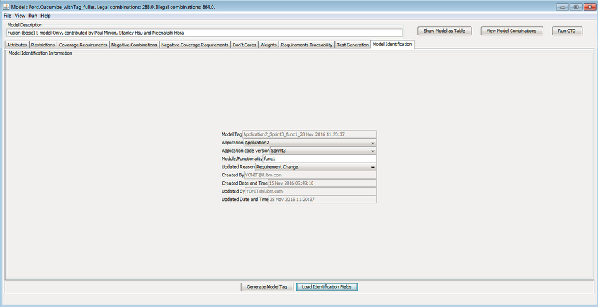
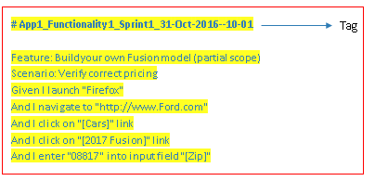
Model Identification

Slide 24
FoCus Data
FOCUS data assists in a more automated test flow by capturing the content of the database in a CTD model with guidance from the user.
IBM FOCUS built-in database importer is a tool which assists in semi-automatically creating a data model based on an existing database schema and contents. The different tables columns in the databse are considered candidates for model attributes and the existing data values in these columns candidates for attribute values.
To create a data model based on an existing database start IBM FOCUS and choose File->Import->From Database.

Slide 25
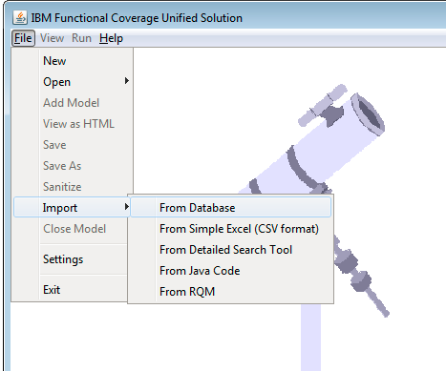
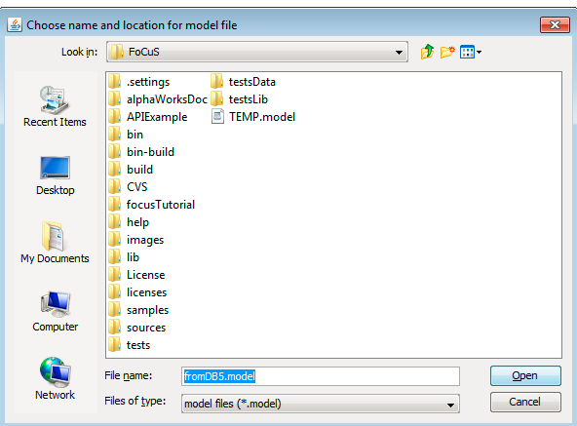

Slide 26
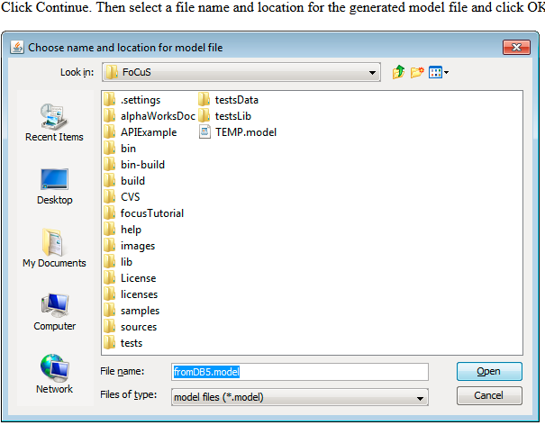
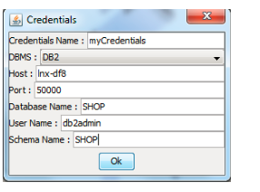

Slide 27
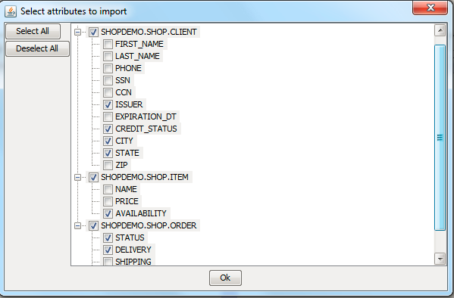
A tree display of the databse tables and columns will appear. The columns are candidates for the generated model attributes. Select a subset of them to include in the generated model.

Slide 28
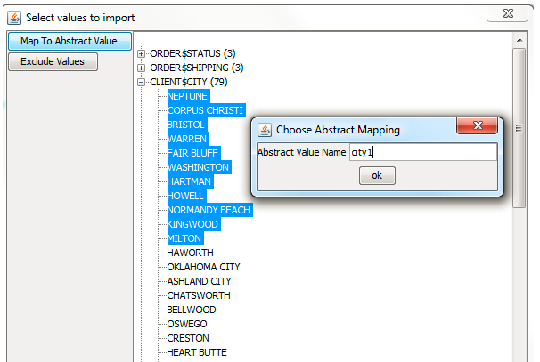
The next step is to select the generated model's attribute values. The candidates for these are the concrete values in the selected columns of the existing database and they can also be mapped to abstract values.

Slide 29
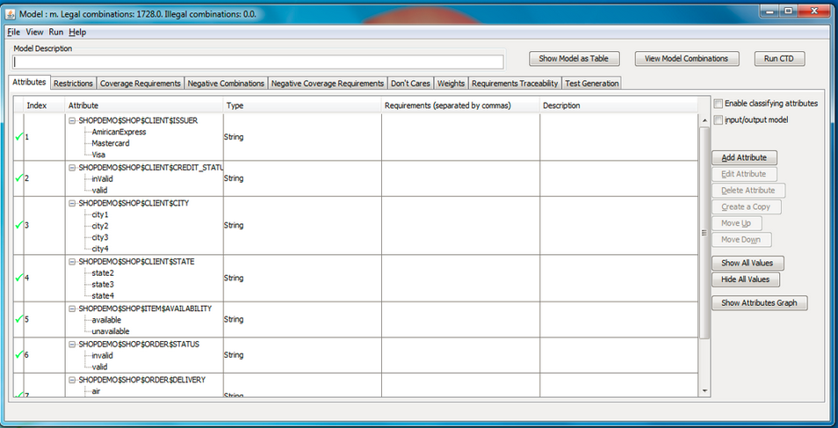
Finally a model is generated and opened containing the selected attributes and values

Slide 30
Reference links
India Combinatorial Test design Community
https://w3-connections.ibm.com/communities/service/html/communitystart?communityUuid=43692495-30a1-4f5f-b55f-8923522eafba
CTD Online course link
https://w3-connections.ibm.com/wikis/home?lang=en-us#/wiki/W4bbb8b568eba_4c68_8c32_24febf3609ea

Slide 31


Slide 32


